Slide 1
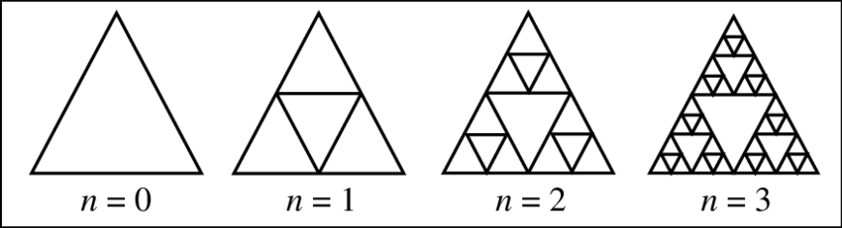
M04 L23 Recursion Introduction

Slide 2
Today
Check in
Goals
Define recursion and identify problems that benefit from recursive solutions.
Distinguish between base case and recursive case.
Trace execution of simple recursive algorithms.
Understand differences between recursion and iteration.
Interactively visualize stack frames and recursive behavior.
Fix and write recursive code
Analyze when to use recursion and when it should be avoided.
Readings recursion

Slide 3
Concepts
Abstract Classes
Abstract classes provide a base for other classes to extend.
They may include abstract methods (no body) and concrete methods.
Used to define a common structure across multiple related classes
Interfaces
Interfaces define a contract that a class agrees to fulfill.
All methods in an interface are implicitly abstract and public.
A class can implement multiple interfaces, allowing for flexible designs.
Used when multiple unrelated classes need to share behavior.
Generics
Generics enable type-safe collections and classes.
Instead of using raw types, generics allow specifying a type
Prevents runtime type errors and eliminates the need for casting.
Improves code readability and reusability.

Slide 4
Concepts
ArrayLists and LinkedLists
ArrayList offers fast access but slower inserts/deletes in the middle.
LinkedList provides efficient insertions/removals but slower access by index.
Implement LinkedLists to manage dynamically growing inventory (cars, books).
Sorting and Searching
Collections are sorted using Comparator and .sort().
Searching is done with for loops or by storing results in a temporary ArrayList.

Slide 5
Concepts
Queues
Queues process elements in FIFO (First-In-First-Out) order.
Java’s LinkedList can also be used as a queue.
Stacks
A stack is a Last-In-First-Out (LIFO) structure.
The last element added is the first one removed.
Common operations include:
push() to add an element
pop() to remove the top element
peek() to view the top element without removing it
Useful for undo features, expression evaluation, and depth-first search algorithms.
Java provides a Stack<E> class
Maps
Maps store data as key-value pairs for fast lookup.
HashMap is used to associate a unique key (e.g., title, location) with an object.

Slide 6
When to Use Arrays
Use arrays when:
You know exactly how many elements you'll store.
You want to store primitive types (like int, double) or objects and don’t need to resize.
You care about fast access (constant time using index)
Key Features:
Fixed size.
Fast access by index (O(1)).
Cannot grow or shrink automatically.
Example: int[] nums = new int[10];

Slide 7
When to Use LinkedLists
Use linked lists when:
You need to insert or remove elements in the middle of the list frequently.
You don’t care about random access (linked lists are slow to access by index).
Key Features:
Can grow and shrink easily.
Efficient at adding/removing elements from the start or middle.
Poor performance for random access.
Useful for implementing queues and stacks.

Slide 8
When to Use ArrayLists
Use ArrayLists when:
You don’t know how many items you’ll store.
You want to add/remove items frequently.
You want automatic resizing (no need to worry about capacity).
You want to sort and search with utility methods (e.g., Collections.sort()).
Key Features:
Resizable array.
Stores objects (not primitives directly).
Good for general use when order matters and size changes.
Slower than arrays for access but flexible.

Slide 9
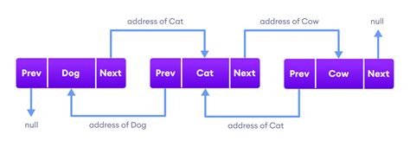
HashMap
How HashMap in Java works internally? - Explained with animation.
Using Linked List with Queues and Stacks rather than an ArrayList when
You are implementing a queue, stack, or deque.
You frequently add/remove elements from the front or end.
You don’t need fast random access (like get(i)).

Slide 10
Sierpinski Triangle
Sierpinski triangle What pattern do you see? How could each step be broken into smaller version of itself?
This self-similar structure is what recursion is all about.
public class MainClass {
public static void main(String[] args) {
printStars(5);
}
public static void printStars(int n) {
if (n == 0) return;
printStars(n - 1);
System.out.println(repeat('*',n));
}
public static String repeat(char printChar, int times) {
if (times == 0) return "";
return printChar + repeat(printChar, times - 1);
}
}
Write on paper what you think the output will be for this program.
Discuss what you notice about this code.

Slide 11
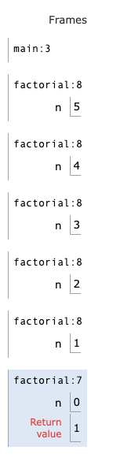
Recursion and Factorial
How does the stack grow and shrink?
What is 5 factorial? Explore Factorial Calculate n!
A recursive method is a method that calls itself to solve a smaller piece of the same problem.
Put the following code in Visualize code in Java to see how to use recursion to calculate factorial and the stack frames.
Execution Steps:
factorial(5) returns 5 * factorial(4)
factorial(4) returns 4 * factorial(3)
factorial(3) returns 3 * factorial(2)
factorial(2) returns 2 * factorial(1)
factorial(1) returns 1 * factorial(0)
factorial(0) hits the base case and returns 1
Now the calls return in reverse:
factorial(1) returns 1 * 1 = 1
factorial(2) returns 2 * 1 = 2
factorial(3) returns 3 * 2 = 6
factorial(4) returns 4 * 6 = 24
factorial(5) returns 5 * 24 = 120
public class MainClass {
public static void main(String[] args) {
int result = factorial(5);
System.out.println("factorial result is " + result);
}
public static int factorial(int n) {
if (n == 0) return 1;
return n * factorial(n - 1);
}
}
What will cause the recursion stop?

Slide 12
What is Recursion?
A recursive method solves a big problem by solving smaller versions of the same problem.
Every recursive method needs:
A base case – this is the simplest possible input, and the method knows exactly what to return.
A recursive case – this reduces the problem and makes the method call itself with a smaller version of the input.
As recursive calls are made, they build up on the call stack.
Once the base case is reached, results begin to return one by one back through the stack.
What happens if the base case in never reached?

Slide 13
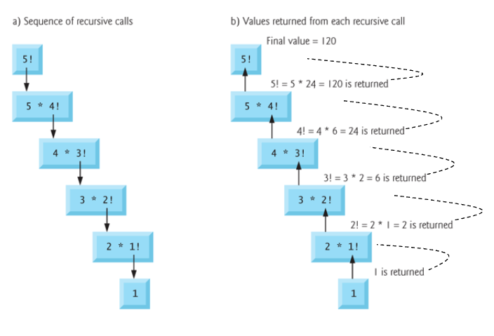
Recursion Summary
public static int factorial(int n) {
if (n == 0) return 1;
return n * factorial(n - 1);
}
Base Case: The condition that stops the recursion. method does not call itself – non-recursive part
Recursive Case: The part that reduces the problem and calls the method again.
Call Stack: The internal mechanism that tracks active method calls. Each recursive call adds a frame to the stack.
Think of it like going down a staircase (recursive calls), and then climbing back up (returning results).
If a recursive method does not have a base case to stop it:
Causes infinite recursion
Call stack will overflow!

Slide 14
Recursion Output
Can you follow this code now to be able to explain the base cases, recursive cases and stack frames and show what the output will be?
Write the output on paper. When you finish Visualize code in Java
public class MainClass {
public static void main(String[] args) {
printStars(5);
}
public static void printStars(int n) {
if (n == 0) return;
printStars(n - 1);
System.out.println(repeat('*',n));
}
public static String repeat(char printChar, int times) {
if (times == 0) return "";
return printChar + repeat(printChar, times - 1);
}
}

Slide 15
Explore Recursion: Sum Array
While this example is not a good example to use recursion use it to understand the recursion when working with a data structure - array. Step through the code and explore recursion with the stack and heap. Visualize code in Java
public class MainClass {
public static void main(String[] args) {
int[] arrayNumbers = {2, 4, 6, 8, 10};
int result = sumArray(arrayNumbers, arrayNumbers.length);
System.out.println("factorial result is " + result);
}
public static int sumArray(int[] arr, int n) {
if (n == 0) return 0;
return arr[n-1] + sumArray(arr, n-1);
}
}

Slide 16
When To Recurse
The maximum recursion depth is predictable and small, meaning you know in advance how many times the method will call itself, and that number isn't too large. For example, factorial(5) makes 6 total calls. This makes recursion safe to use because it won't overwhelm the call stack.
The problem has a recursive structure (e.g., trees, graphs, nested folders)
The recursive solution is simpler and clearer than an iterative version
You need to backtrack (e.g., solving mazes, puzzles)
Examples:
Computing factorial or Fibonacci numbers
Traversing a binary tree
HTML/XML DOM traversal
Drawing fractals (visual recursive art)
Parsing expressions (e.g. calculator)
Directory traversal (e.g. files/folders)
Solving the Tower of Hanoi puzzle
Backtracking (mazes, puzzles)
Sorting algorithms (Merge Sort, Quick Sort)

Slide 17
When Not To Recurse
Performance is critical (recursive calls can be slower and more memory-intensive)
Stack depth could exceed the limit (deep recursion may cause stack overflow)
An iterative solution is easier or more intuitive
Examples
Iterating over a flat array
Summing a million numbers

Slide 18
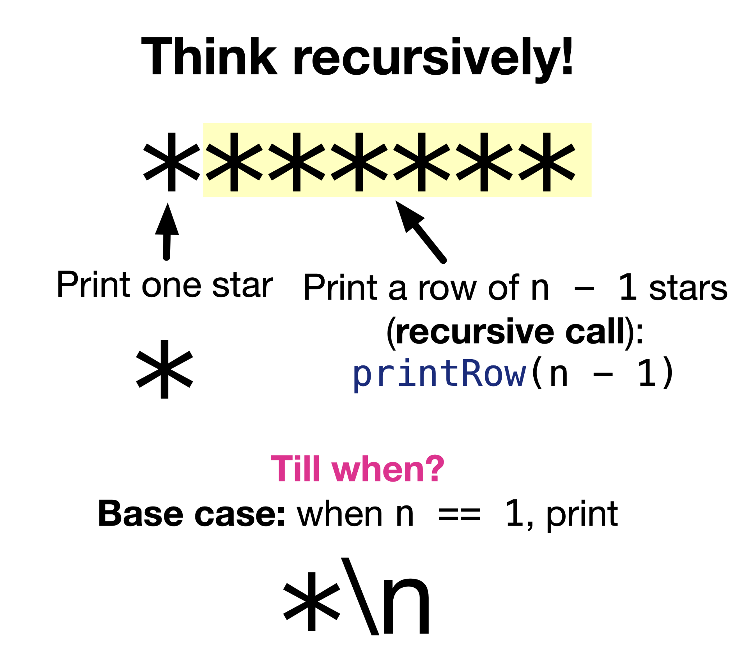
Designing Recursive Methods
Recursive methods, like for loops, keep track of where they are by moving a variable from one end of a sequence to the other. We’ll call that variable n.
There are three things to think about when you are designing a recursive method:
The beginning case: The initial value or position of n
The recursive case: Where the method calls itself, with a value of n closer to the base case.
The base case: The case at the end of the recursion, where n has reached its limit.

Slide 19
Iteration vs Recursion
Difference between Iteration and Recursion
Iteration
Emphasis – keep repeating until a task is done
Uses an iteration statement (i.e., while, for)
Achieves repetition using iteration statement
Terminates when loop continuation condition fails
Infinite loops occur when loop continuation condition never changes to false
Recursion
Emphasis – solve a large problem by breaking it down into smaller and smaller pieces until you can solve it, then combine the pieces
Uses selection statement (i.e., if)
Achieves repetition using repeated method calls
Terminates when a base case is recognized
Infinite recursion occurs if recursive step doesn’t reduce problem so it converges to base case

Slide 20
Recursion Lab
2. Fix the issue in the following code
public static int countdown(int n){
if (n == 0){
System.out.println("Blast off!");
}
System.out.println(n);
countdown(n - 1);
}
1. What prints
public static void mystery(int n){
if (n <= 0){
Return;
}
System.out.print(n + " ");
mystery(n - 1);
System.out.print(n + " ");
}
public static int badRecursion(int n){
if (n == 1){
return 1;
}
return n * badRecursion(n - 2);
}
3. Write pseudocode for a recursive method that prints all elements of an array backward.

